Slide 1

AOLME Curriculum SESSION 2
MATERIALS DEVELOPED BY THE AOLME PROJECT AT THE UNIVERSITY OF NEW MEXICO, PLEASE DO NOT COPY OR DISTRIBUTE ANY OF THESE COPYRIGHTED TASKS WITHOUT PROPER AUTHORIZATION OF PROJECT

Slide 2


Level 1
SESSION 1: Basic of Raspberry PI and Linux-(motivational overview of projects-images, ls, cd) SESSION 2: Introduction to Python Programming (print, algebra, strings) SESSION 3: Algorithms (for and while loops, range commands, if statements, inequalities, sprite movement) SESSION 4: The Coordinate Plane and Black & White Images in Python SESSION 5: Binary and Hexadecimal number systems SESSION 6: Images and Their Components (histograms) SESSION 7: Creation of Images and Video FINAL PROJECT: VIDEO

Slide 3
introduction to Python Programming
OBJECTIVES:
Apply basics of Python Programming.
Program basic operations and variables in Python.
Solve and create own operations, and arithmetic-algebraic expressions.
Program a number guessing game using Python.

Slide 4

Selected ACTIVITIES
1. Exploring Python Programming (print, strings, basic operations)
2. Programming Operations with Python (linear equations, order of operations, and complex expressions)
3. Creating Your Guessing Game w/ Python (design, program, and share game by altering initial, base codes)

Slide 5


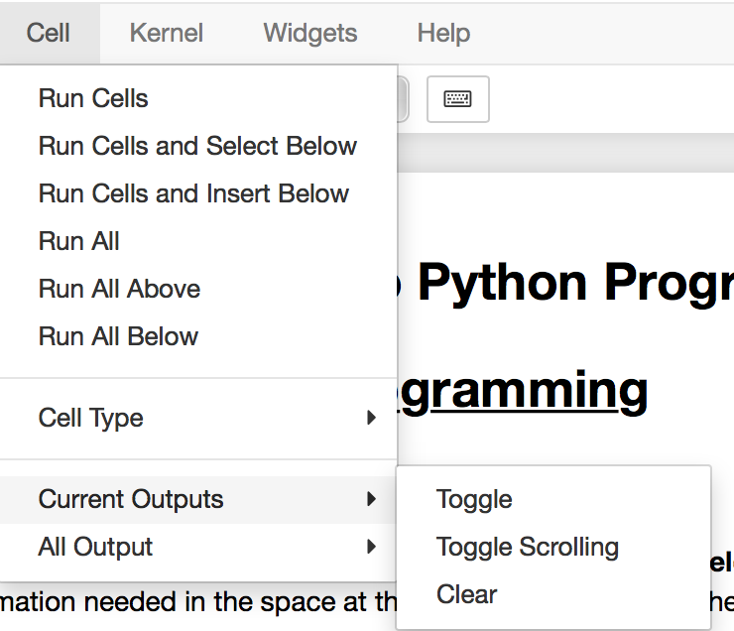

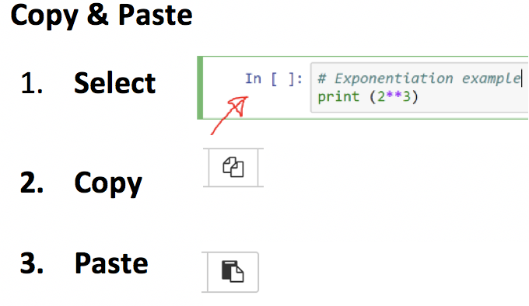
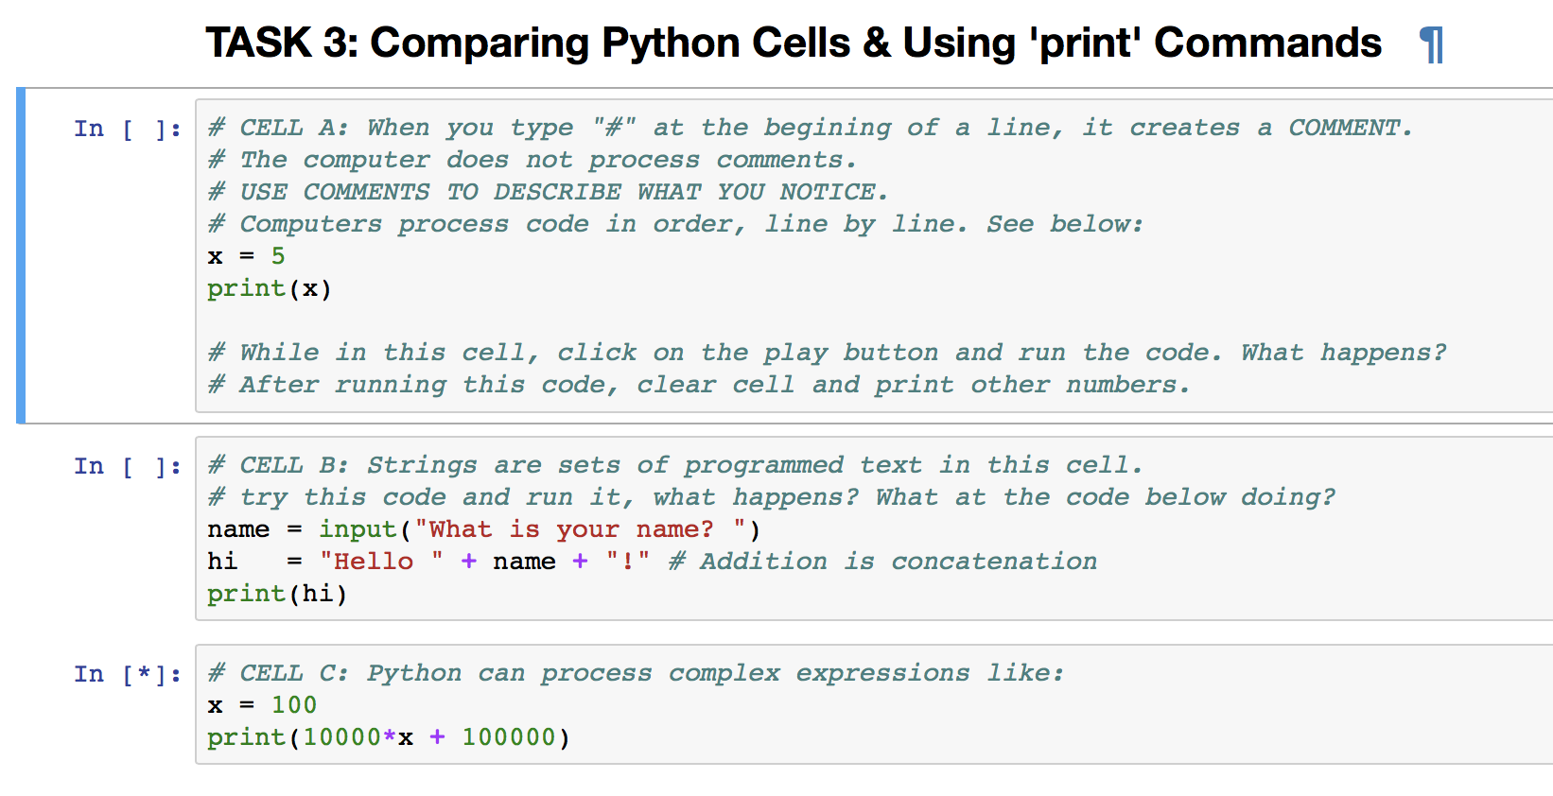

2.1. Exploring Programming with Python
Note: The numbers in Card match the Tasks numbers in Jupyter Notebook.
1. Practice Python programming using Jupyter. Open the terminal: & type in: jupyter notebook. Hit Enter & in Jupyter open ‘Session 2’ folder, then open ‘Untitled’ file.
2. To play the Guessing Game: (a) open Session 2 file in Jupyter,
(b) In task 2, select the cell named: EXAMPLE with game code,
(c) click ‘run’
(d) at bottom, enter data it asks for
(e) take turns
(f) clear cell by clicking on ‘run’ again
In ‘Untitled’ file, navigate Jupyter by exploring what each icon on the the taskbar does.
What’s a cell?
SAVE your work every time by clicking on this icon.
A cell looks like a line to enter information. You can copy and erase cells..
To clear cells follow these steps.
3. Run & play CELLS A-C in Task 3. What do you notice about the print command?
4. Discuss & Create: Based on what you did in task 3, complete the challenges in TASK 4 in Jupyter. Take turns.
Be creative and have fun!
Why does the cell blue frame mean?
What do you notice about the red text and what appears below the cells? What if you changed the red text?
These boxes are (Python or Text) cells: some have: ‘In [ ]’ and others don’t. Why?
Have you played the guessing game before?
AOLME PROJECT - LEVEL 1- SESSION 2- 2018
MATERIALS DEVELOPED BY THE AOLME PROJECT AT THE UNIVERSITY OF NEW MEXICO, PLEASE DO NOT COPY OR DISTRIBUTE ANY OF THESE COPYRIGHTED TASKS WITHOUT PROPER AUTHORIZATION OF PROJECT

Slide 6

2.1. Exploring Programming with Python
Note: The numbers in Card match the Tasks numbers in Jupyter Notebook.
Resources for the Activity
Recommended Steps for the Activity
Activity Card
Folder: /home/pi/AOLME/Session 2/
the “Jupyter” notebook accessed via Terminal
Raspberry Pi and Monitor
Student journal
Make sure that for the first task students open the ‘Untitled’ file in Session 2 folder. Have them type and try all icons in taskbar. Have them explore and then talk about what the discover. They might make connections to what they’ve done in other computers.
Have students realize different types of cells.
When playing guessing game, let students take turns playing game, maybe by pairs? Taking turns typing?
Task 3 it’s important to notice ‘print’ and what if they didn’t typed print? What happens? Let them experiment especially notice that the red text or strings can be changed to any language even, but green words can’t be changed.
Have students debrief what they learned by experimenting and have them write notes in journal.
Everyone in the team gets to play a role:
Discussion Expert: Leads the team discussion asking questions about what the session is about.
Fair Participation Expert: makes sure of fair participation of everyone.
Hardware Setup/Teardown Expert: in charge of setting up & putting away materials and computer equipment.
Summary Expert: summarizes and records team questions and what the teams has learned.
Activity 1 Goal: Apply basics of Python Programming.
AOLME PROJECT - LEVEL 1- SESSION 2- 2018
MATERIALS DEVELOPED BY THE AOLME PROJECT AT THE UNIVERSITY OF NEW MEXICO, PLEASE DO NOT COPY OR DISTRIBUTE ANY OF THESE COPYRIGHTED TASKS WITHOUT PROPER AUTHORIZATION OF PROJECT

Slide 7
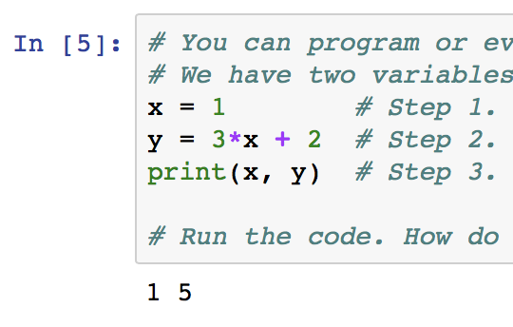


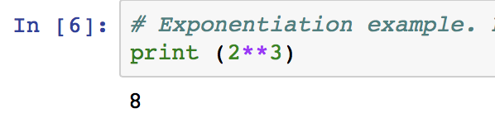
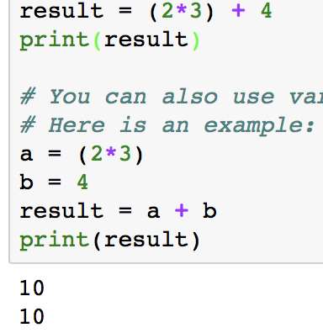
2.2. Programming Number Operations w/ Python
Note: The numbers in Card match the Tasks numbers in Jupyter Notebook.
1. Let’s use Math and Algebra to program with Python.
2. In TASK 2 in Jupyter, program and operate equations.
What do we remember about linear equations?
Play w/ these equations. Come up with other values. What happens?
How are these numbers related to the codes above?
What variables do you see?
What’s a variable?
How are these ‘x’ and ‘y’ different from the ‘x’ and ‘y’ of an image coordinate?
3. What do you know about PEMDAS? How can order help?
4. Complete rest of tasks in section 2.2. In Task 4, think of variables and PEMDAS. How would you group these numbers?
In Equations, we operate in this order:
P: Parenthesis.
E: Exponents.
MD: Multiplications and divisions from left to right.
AS: Additions and subtractions from left to right.
What do you think about doing Math with Python?
We’re almost ready to program the guessing game!
When running the first cell in Task 3, why do you get two 10s? Change the variable values or operations to get different numbers.
AOLME PROJECT - LEVEL 1- SESSION 2- 2018
MATERIALS DEVELOPED BY THE AOLME PROJECT AT THE UNIVERSITY OF NEW MEXICO, PLEASE DO NOT COPY OR DISTRIBUTE ANY OF THESE COPYRIGHTED TASKS WITHOUT PROPER AUTHORIZATION OF PROJECT

Slide 8
2.2. Programming Number Operations w/ Python
Note: The numbers in Card match the Tasks numbers in Jupyter Notebook.
Resources for the Activity
Recommended steps for the Activity
Make sure that students understand that variables can be determined in many way. Have them identify and talk about them every time they define them
When running each cell, make sure to have them predict and then try to identify what each code lines does. Perhaps changing numbers can help figure out better what the codes do.
Discuss how the order of operations, grouping and definitions of variables might help solving a problem.
Activity Card
the “Jupyter” notebook accessed via Terminal
Folder: /home/pi/AOLME/Session 2/
Raspberry Pi and Monitor
Student journal
Activity 2 Goal 1: Program basic operations and variables in Python. Goal 2: Solve and create own operations, and arithmetic-algebraic expressions.
AOLME PROJECT - LEVEL 1- SESSION 2- 2018
MATERIALS DEVELOPED BY THE AOLME PROJECT AT THE UNIVERSITY OF NEW MEXICO, PLEASE DO NOT COPY OR DISTRIBUTE ANY OF THESE COPYRIGHTED TASKS WITHOUT PROPER AUTHORIZATION OF PROJECT

Slide 9



2.3. Creating Your Number Guessing Game w/ Python
Note: The numbers in Card match the Tasks numbers in Jupyter Notebook.
What makes this game work?
2. Inverse Operations: Multiplication is the inverse of division
Consider the following for a game:
Give me a number x
Multiply by 2. 2*x
Divide by 2. (2*x)/2=x
After these steps, we are back to x. We "divide by 2" because it is the inverse and it helps get rid of the result from "multiply by 2". Why do we want to get rid of the values we enter?
What’s the inverse operation of addition? Why?
The Number Guessing Game. To make the game work, we need to think about inverse operations.
Why do you think we need inverse operations in the number guessing game?
3. Think: What would this game do?
Give me a number. x
Add 3. x+3
Subtract 3. (x+3)-3=x
4. Design and program in your team a number guessing game. Take turns typing in the codes. Save your work. Use the code in cell 2.3. to start your game. Then, try to see if someone not from your group can play your game.
What would be some values or numbers to combine in the guessing game?
Use paper to check and predict whether your game will work.
Write in journal ideas you learned in Session 2 about Python programming.
AOLME PROJECT - LEVEL 1- SESSION 2- 2018
MATERIALS DEVELOPED BY THE AOLME PROJECT AT THE UNIVERSITY OF NEW MEXICO, PLEASE DO NOT COPY OR DISTRIBUTE ANY OF THESE COPYRIGHTED TASKS WITHOUT PROPER AUTHORIZATION OF PROJECT

Slide 10
2.3. Creating Your # Guessing Game w/ Python
Note: The numbers in Card match the Tasks numbers in Jupyter Notebook.
Resources for the Activity
Recommended steps for the Activity
Have students reflect on how numbers cancel each other through inverse operations.
Have them practice on paper getting rid of numbers to ’guess’ the number.
Let students collaborate and have fun and encourage creativity and communication
Try not to tell them, instead ask questions to prompt their thinking.
Invite members from other teams to play the game of your team.
Activity Card
Folder: /home/pi/AOLME/Session2
the “Jupyter” notebook accessed via Terminal
Raspberry Pi kit
Student journal
Evaluate how did the team roles work?
Discussion Expert: Leads the team discussion asking questions about what the session is about.
Fair Participation Expert: makes sure of fair participation of everyone.
Hardware Setup/Teardown Expert: in charge of setting up & putting away materials and computer equipment.
Summary Expert: summarizes and records team questions and what the teams has learned.
Activity 3 Goal: Program a number guessing game using Python.
AOLME PROJECT - LEVEL 1- SESSION 2- 2018
MATERIALS DEVELOPED BY THE AOLME PROJECT AT THE UNIVERSITY OF NEW MEXICO, PLEASE DO NOT COPY OR DISTRIBUTE ANY OF THESE COPYRIGHTED TASKS WITHOUT PROPER AUTHORIZATION OF PROJECT

